Slide 1
Our Most Popular Brands
Find some Unique Offers

Slide 2
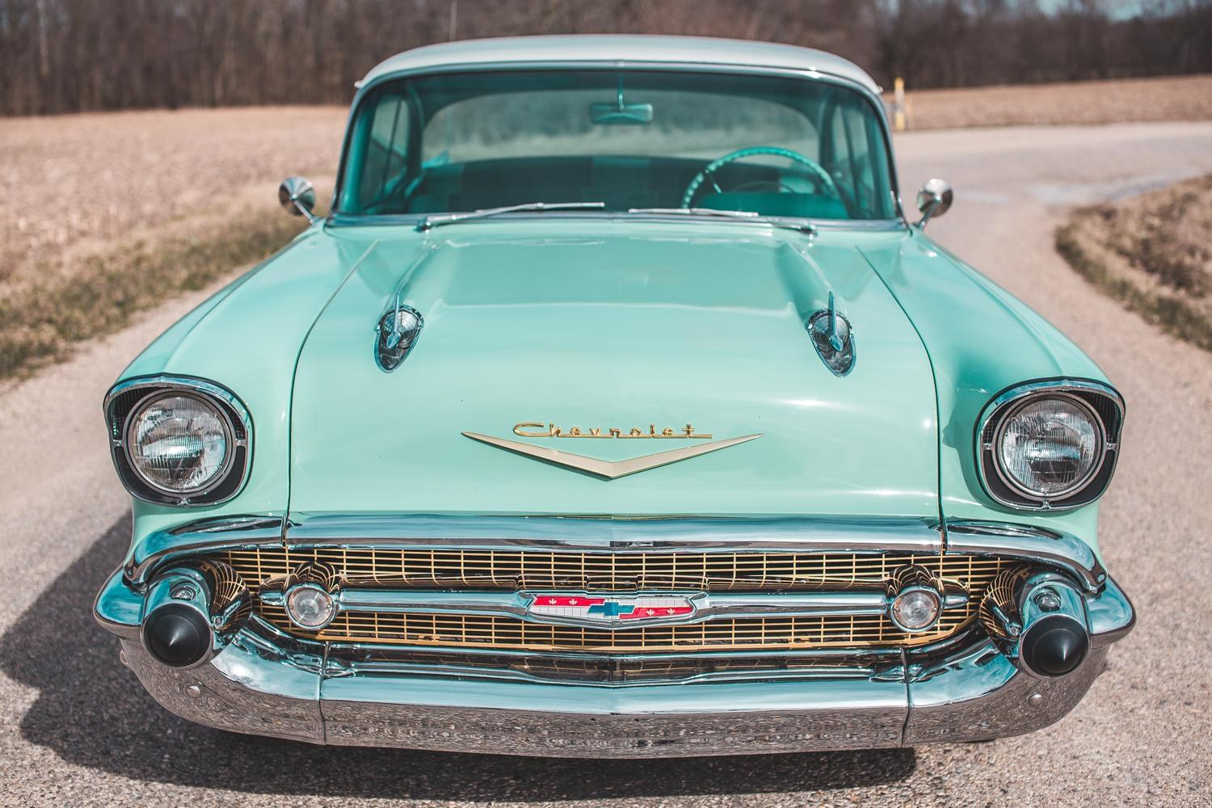
Chevrolet - Ready! Chevy! Go! Find new roads with your Chevy.
Founded in 1911 by Louis Chevrolet and William C. Durant in Detroit, Chevrolet is today a very popular brand for classic cars all over the world. Models like the Pickup from 1946 or the famous Corvette with a V8 engine are in great demand by collectors and dealers.

Slide 3
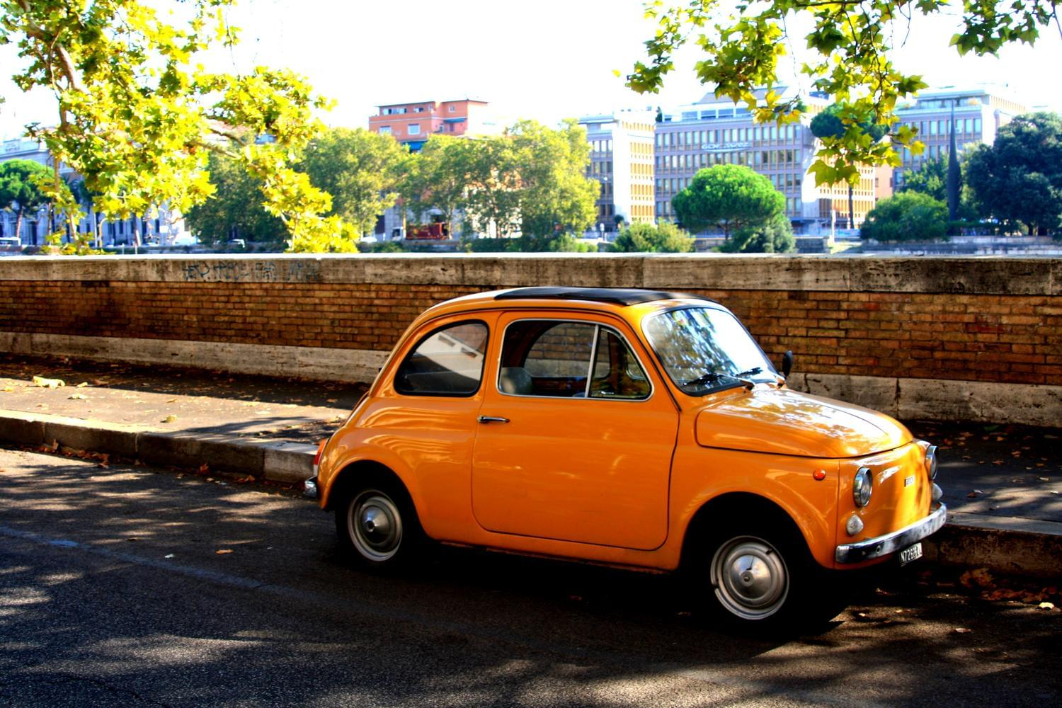
Fiat - Driven by Passion. Fabbrica Italiana Automobili Torino
Italian lifestyle and unique designs, that's what Fiat carries out into the world. Today it's the biggest car manufacturer in Italy and also of whole Europe. Fiat has received many international awards for its cars.

